Slide 1
Engineering
Course Analysis
Group
Members
Names

Slide 2

Motivation and Objective
Technology has been evolving ever so rapidly for the past two decades.
Both students and Departments concerned with
technical learning need to keep up
with the demanding changes.
The Course Catalog of a department gives a brief, yet
exhaustive description of all subjects
covered.
Analysis on a new dataset created from course catalogs provided an interesting challenge to understand how the universities have changed over time.

Slide 3


Methodology
Catalog descriptions were scrapped to analyze the occurrence of every word and pair of words (2006-present)
The unigrams, and bigrams along with their occurrence frequency were stored in a database (managed through SQLite)
Pairs of words (or Bigrams) were of relatively higher relevance ("Signal Processing", "Machine Learning", "Fuzzy Logic", "Integrated Circuits")
Catalogs
Word Frequency database

Slide 4

Methodology
To shorten the features of interest and derive more meaning, lemmatization was used (NLTK python library)
Words with minimal frequency and common words ("credits","pre- requisites", "classes") were discarded, to make the final processed dataset.
Job descriptions from companies were collected and they underwent the above processing as well.

Slide 5
Dataset
Universities
UCSB, UCLA, UCB, UCSD
Departments
CSE, ECE, MAE
4*3*13 – 156 units scrapped
Text analysis– Bigrams, Stemming and Lemmatization (NLTK library), Occurrence frequency analyzed.
Database management tool - SQLite
2006 - 2007
ECE
2018 - 2019
Universities
2006 - 2007
CSE
2018 - 2019
2006 - 2007
MAE
2018 - 2019

Slide 6
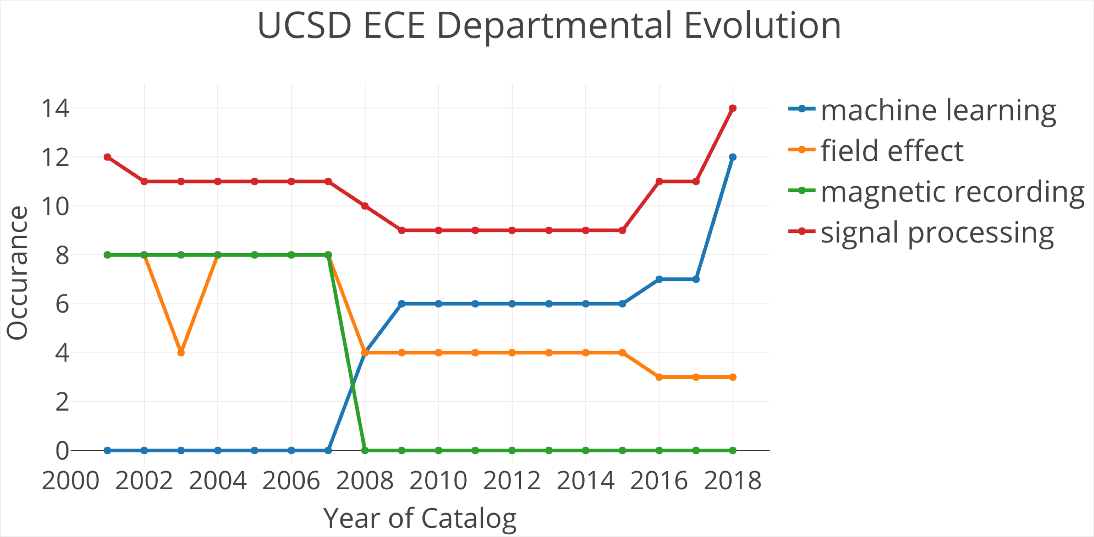
ECE department at UCSD has been dynamic

Slide 7
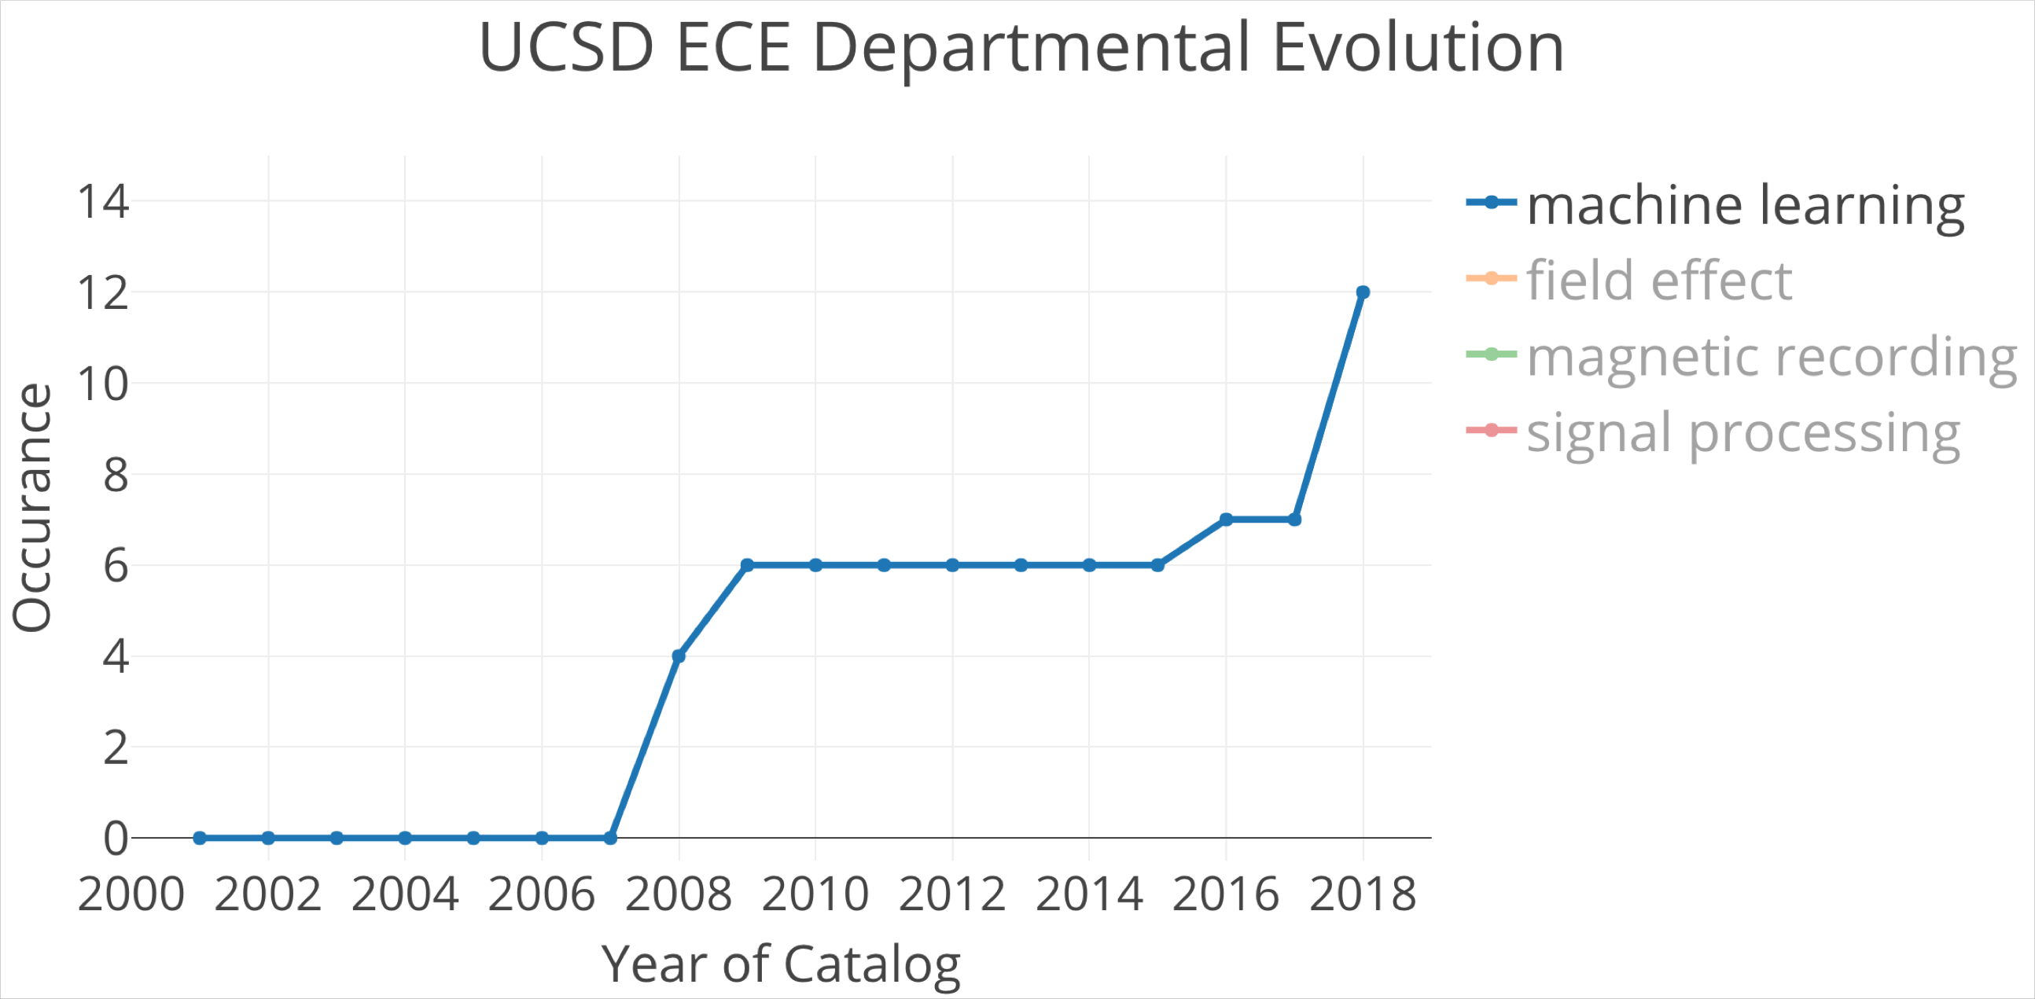
Machine learning has gained increasing attention by industry and public. The department is not left behind.

Slide 8
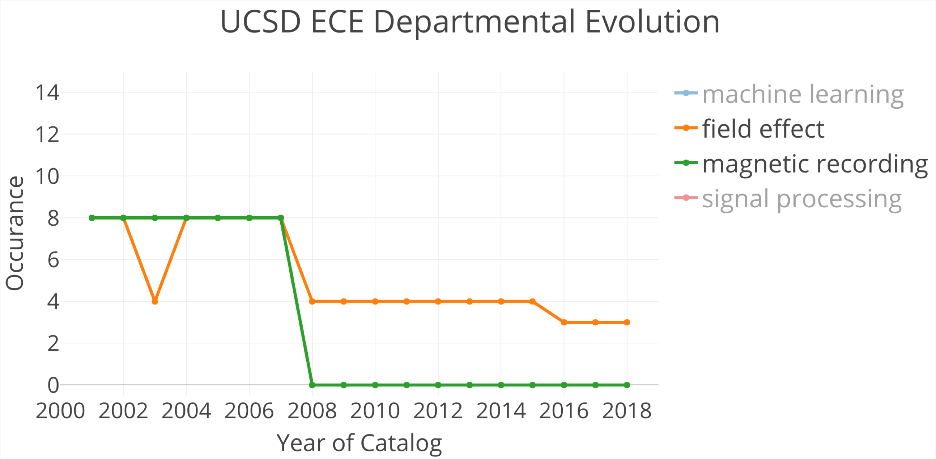
Interest in magnetic recording and field effect has also dropped as expected.

Slide 9
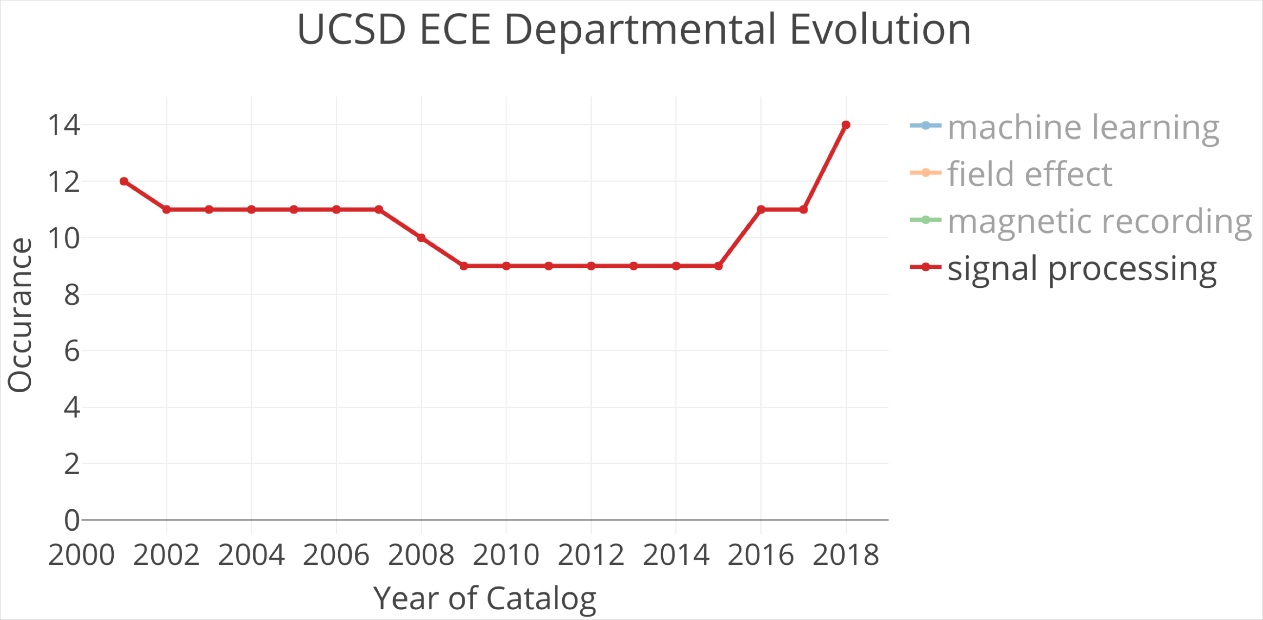
Those ECE core knowledges remain as important parts of the department and new applications of these knowledges are essential for the future.

Slide 10
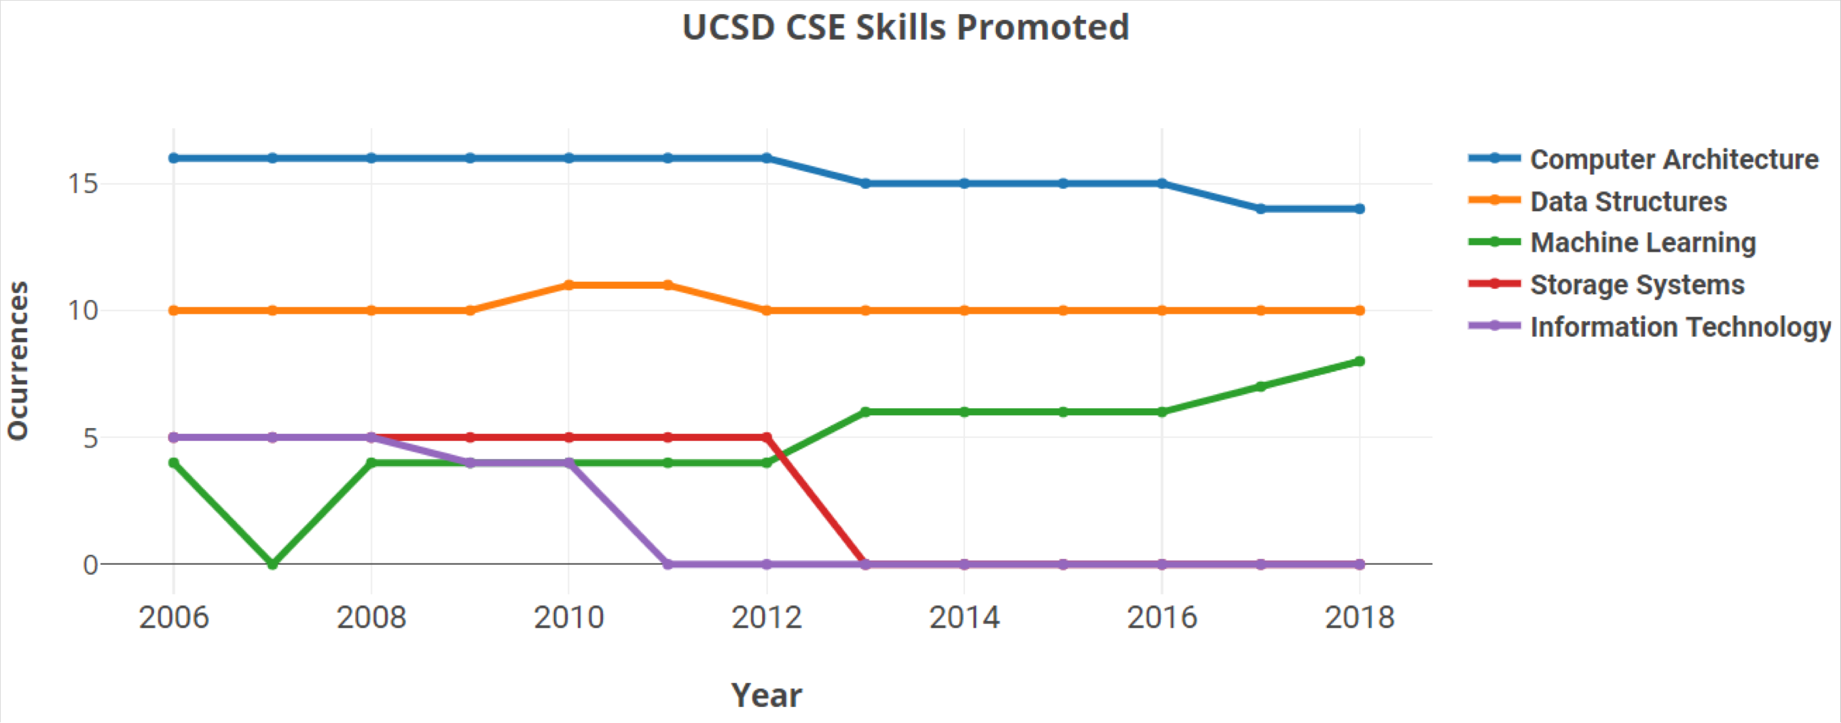
What's hot at UCSD CSE?

Slide 11
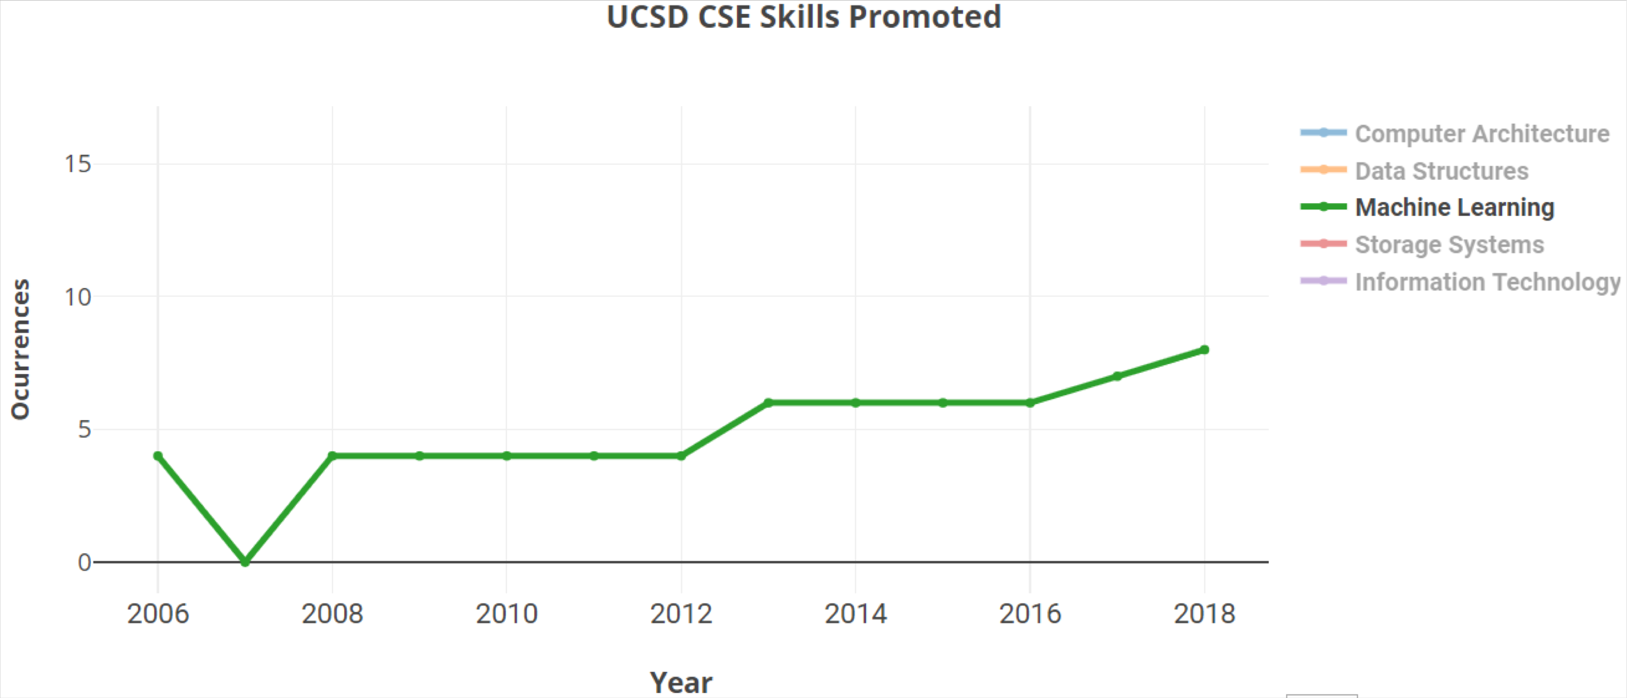
Machine Learning is RISING

Slide 12
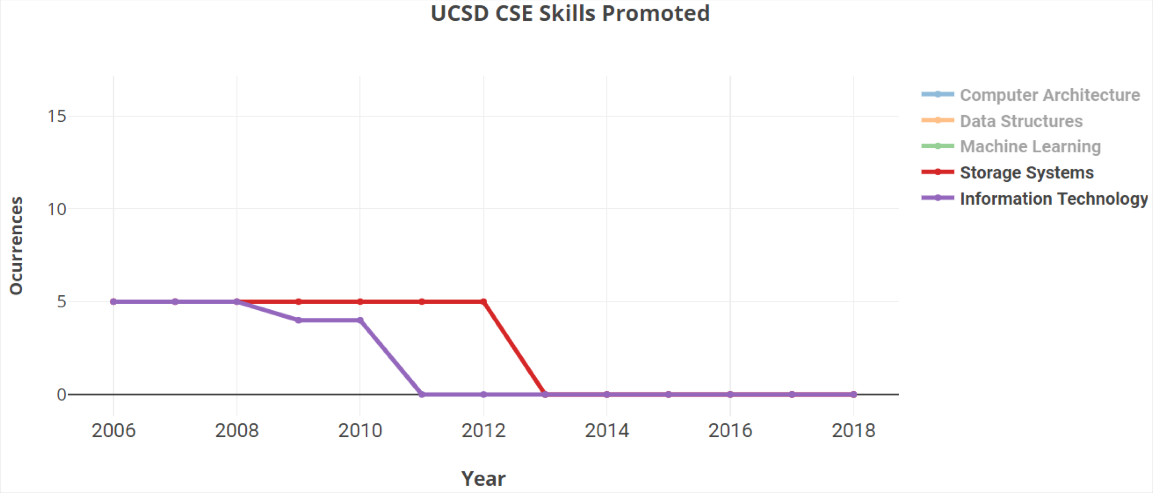
Information Technology & Storage Systems are GONERS

Slide 13
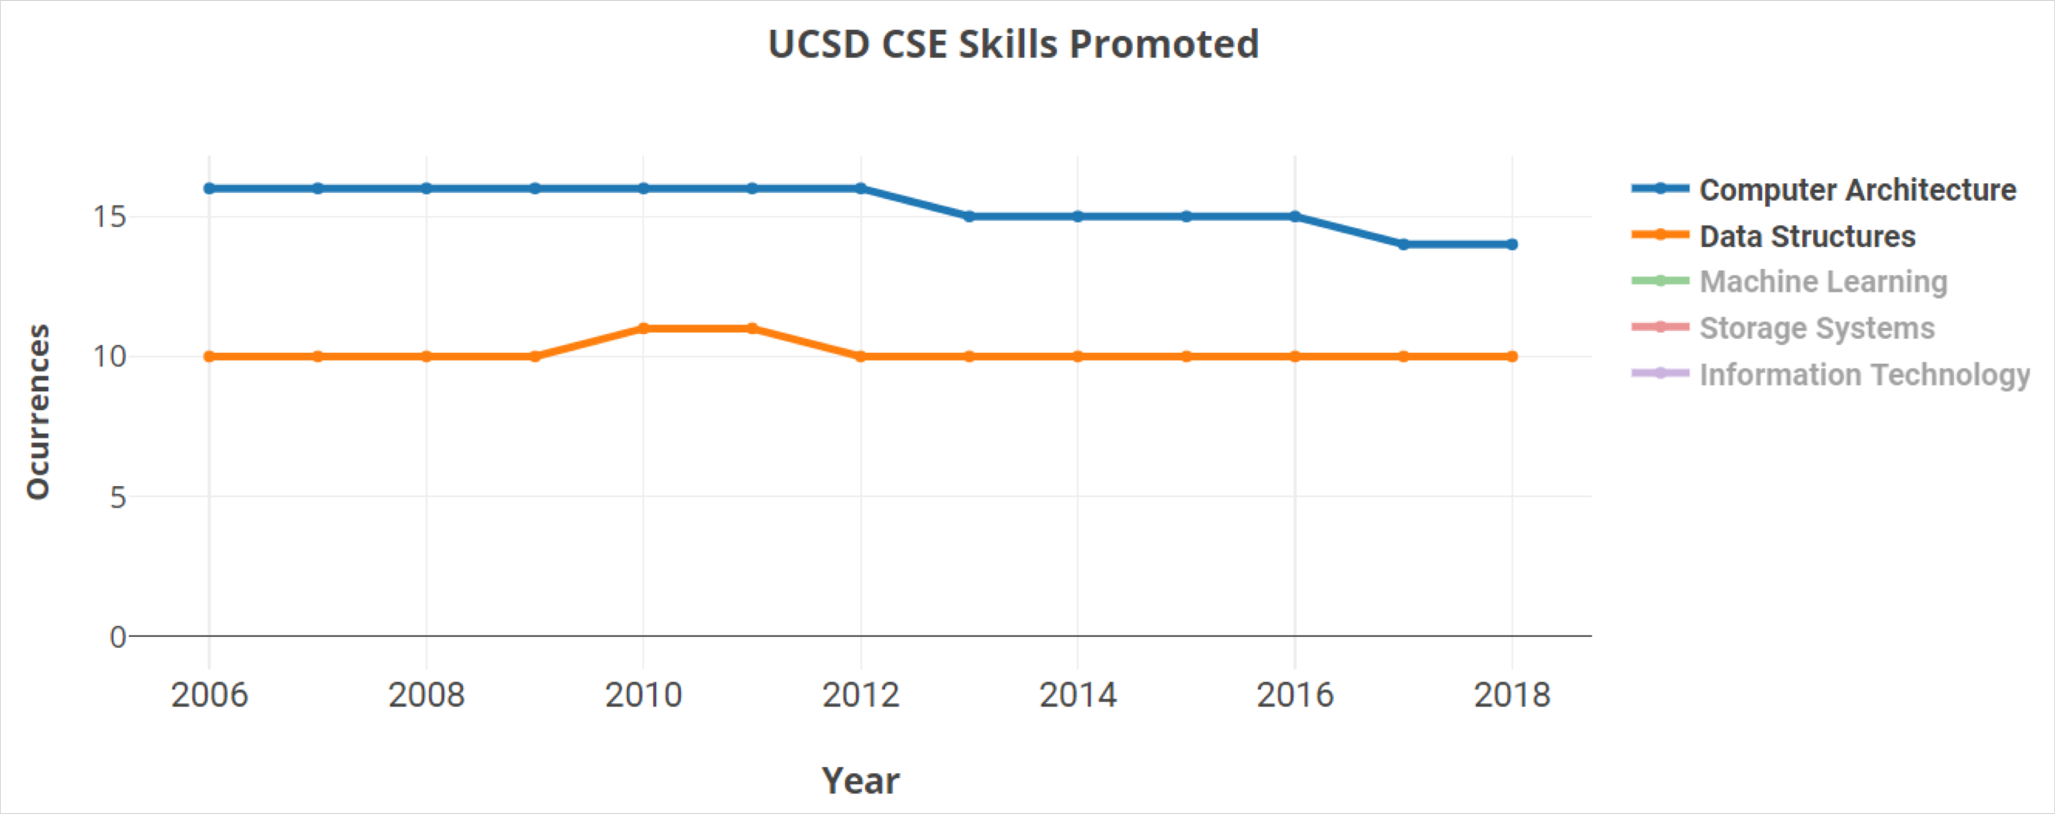
Computer Architecture & Data Structures STAY STRONG

Slide 14
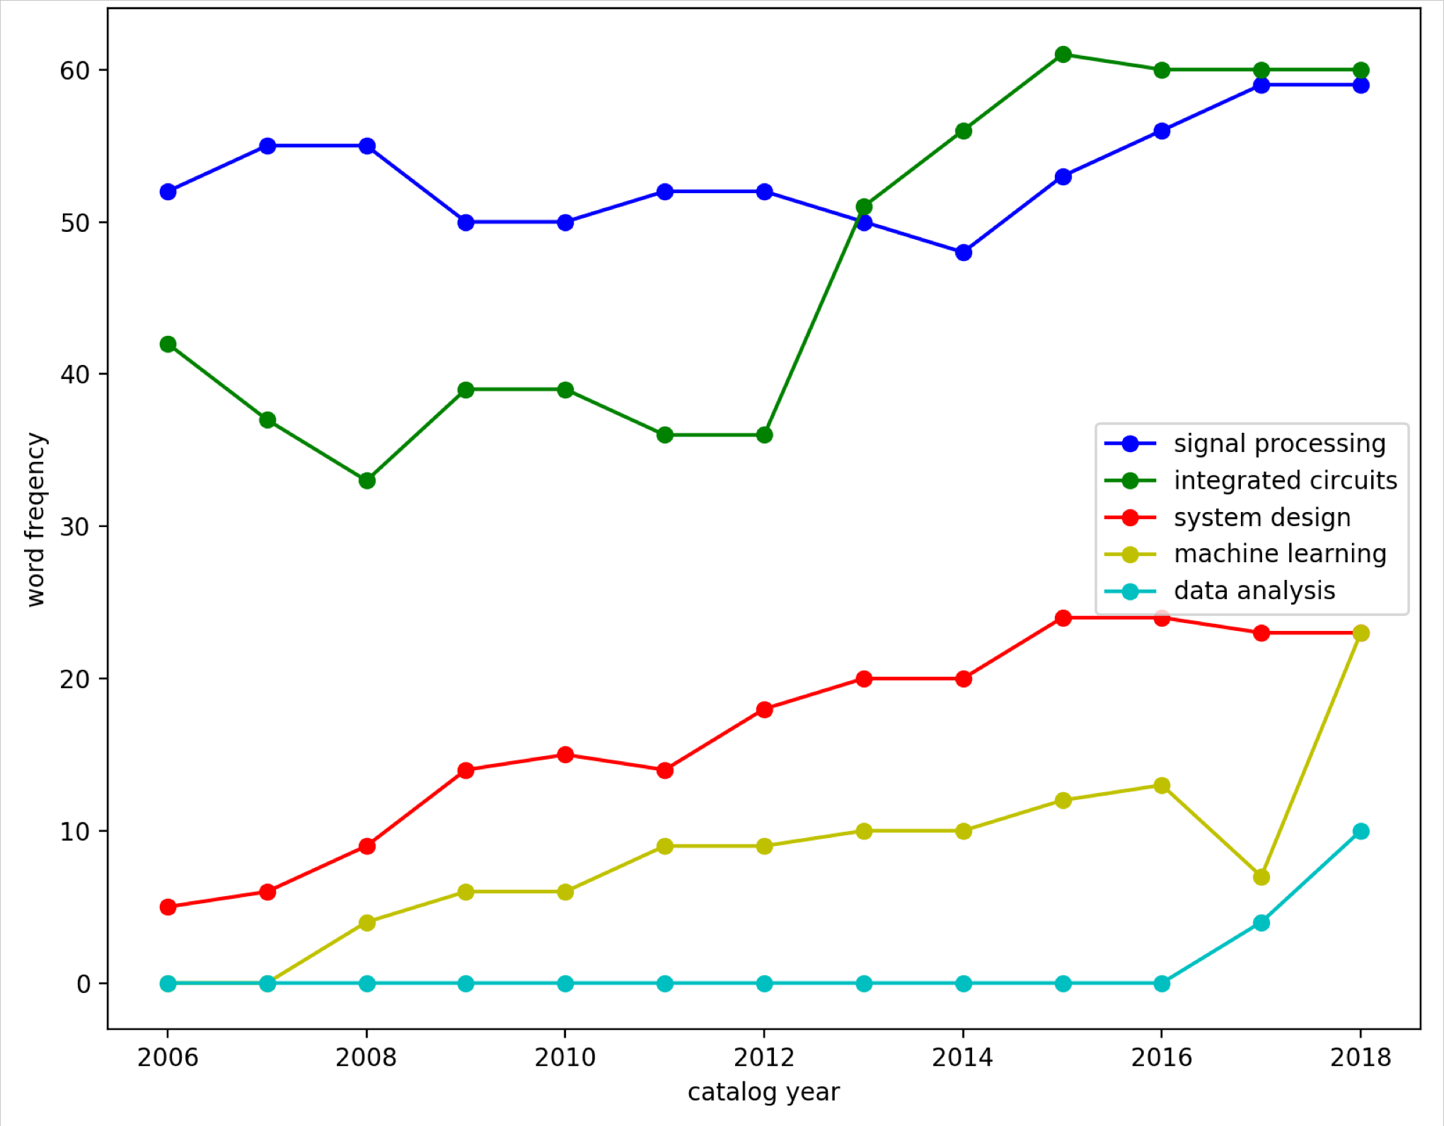
ECE & CSE Departments Change Frequently
MAE lacks booming subjects during the time period
Course Offering in ECE Department

Slide 15
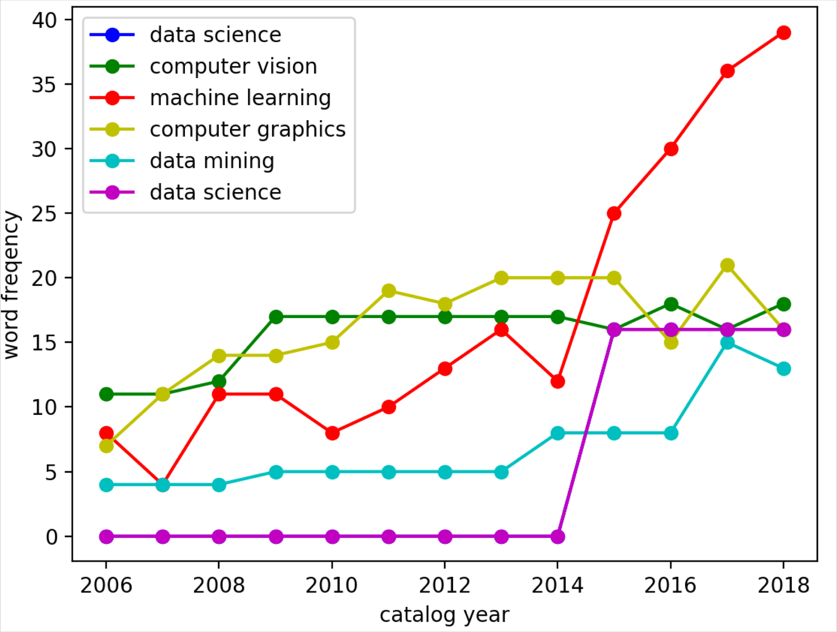
ECE & CSE Departments Change Frequently
MAE lacks booming subjects during the time period
Course Offering in CSE Department

Slide 16
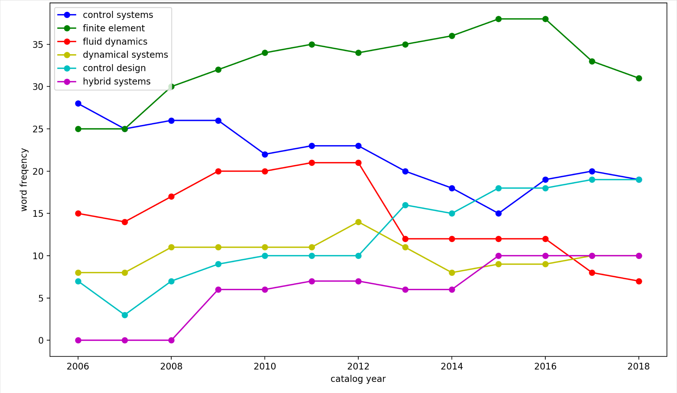
ECE & CSE Departments Change Frequently
MAE lacks booming subjects during the time period
Course Offering in ME Department

Slide 17
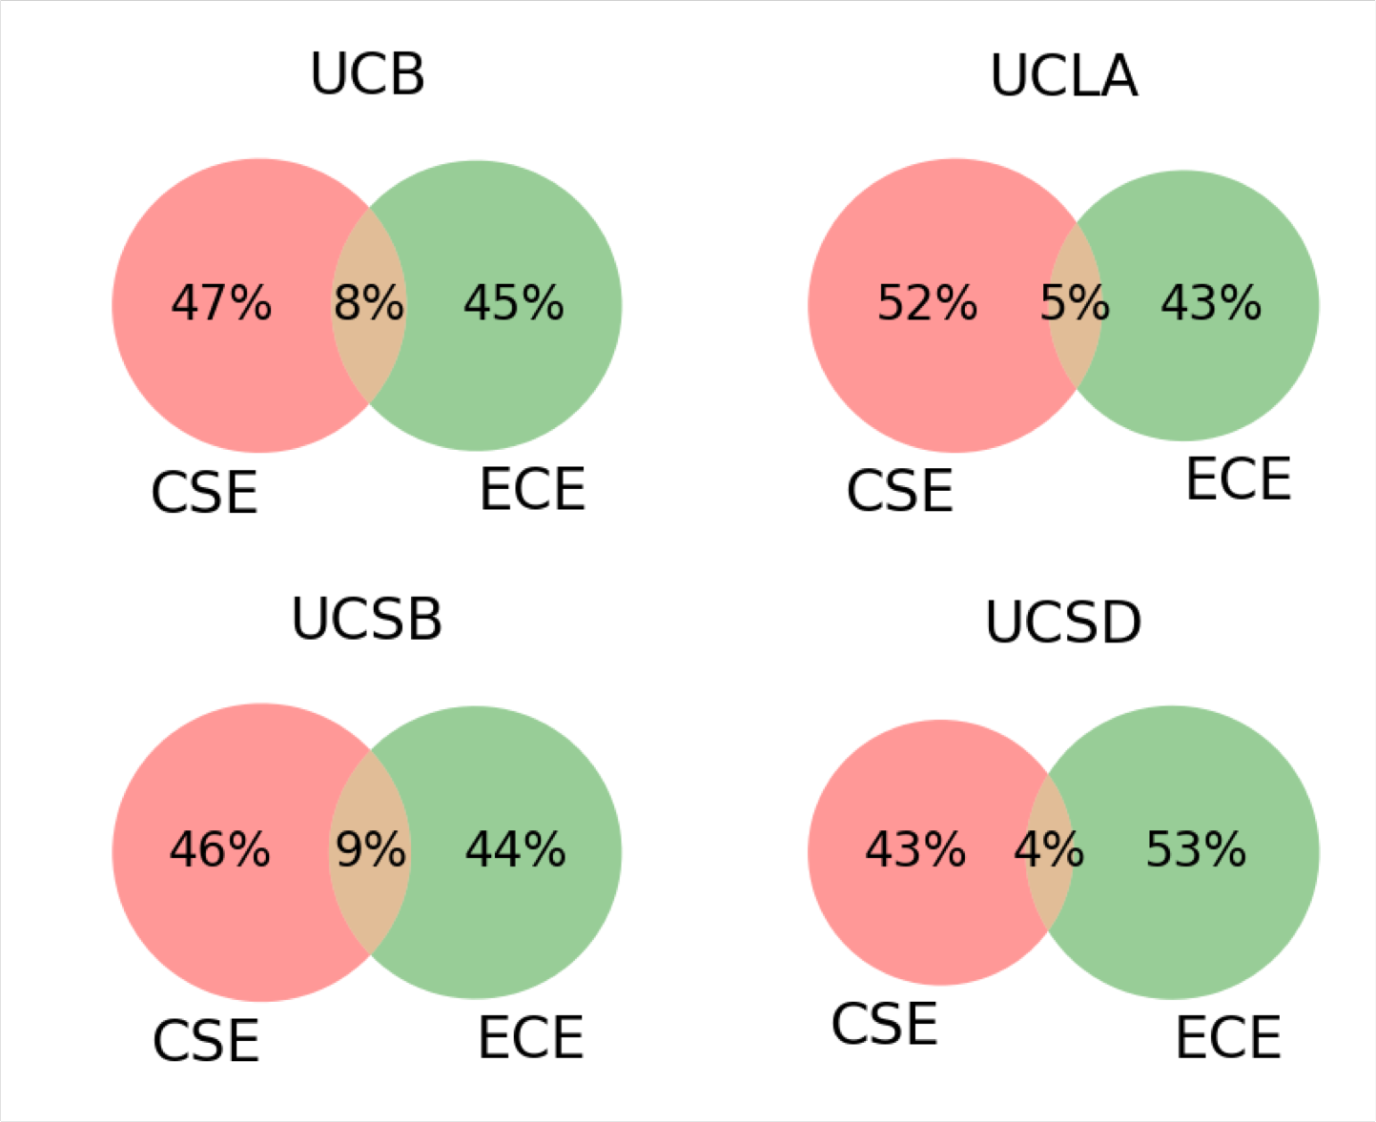
Extent of overlap between CSE & ECE
ECE and CSE department overlap is not very high in general
Overlap is mainly over Artificial Intelligence: Machine Learning, Data Science, Computer Vision
Other common fields: Computer Graphics, Embedded systems, Digital design, Computer Aided Design and System Design

Slide 18
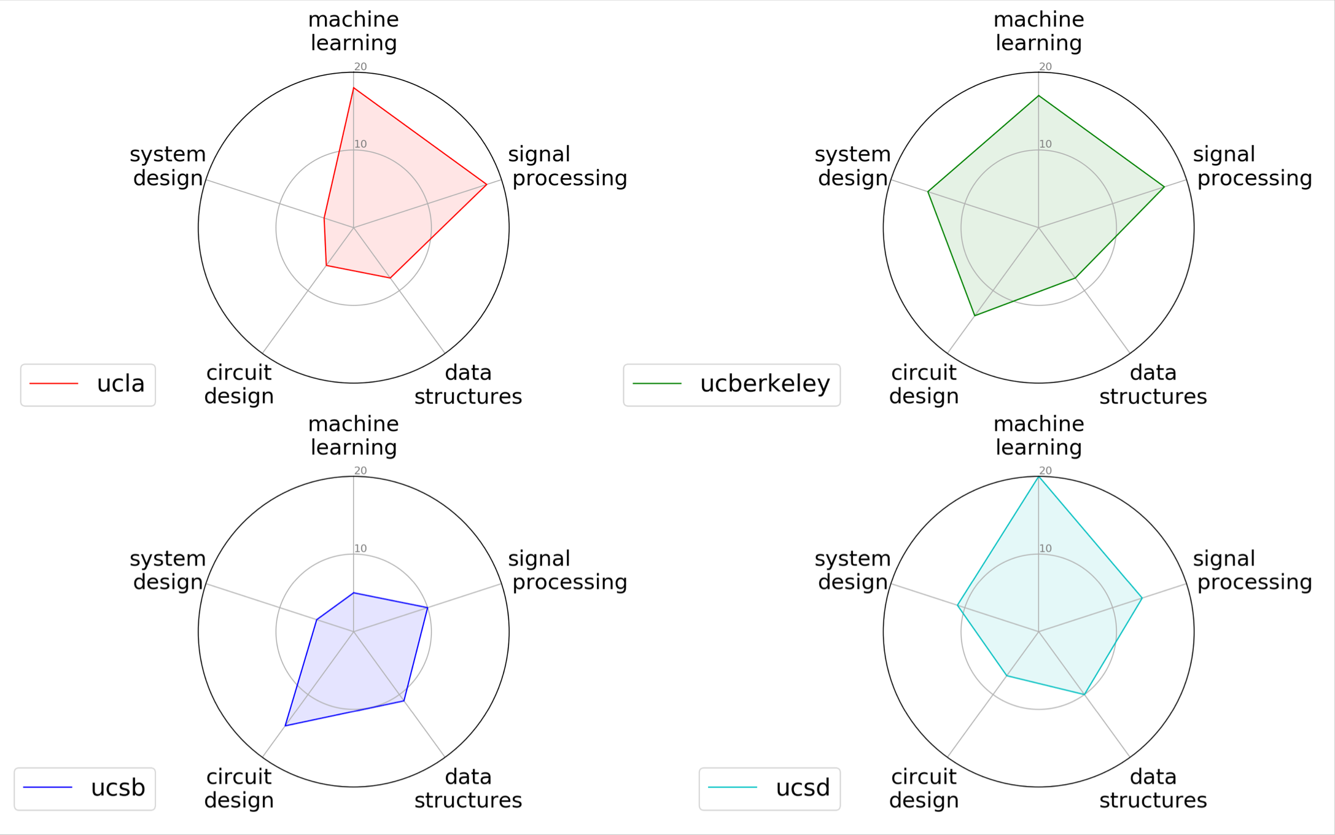










Most universities are concerned with popular topics in industry
Five frequently mentioned topics has been chosen from ten different companies’ job descriptions
Company List:

Slide 19
THANK YOU

